Slide 1

FAST School of Computing • NUCES Islamabad
Localized Offline Urdu (Nastaliq)
Handwritten Ledger Digitization & Auditing
Problem: Digitize unconstrained handwritten Urdu Khatas accurately and auditably without transmitting sensitive commercial records to third-party cloud infrastructure.
Talal Shahid 23i-0594
Irbaz Ali 23i-2075
Muhammad Ibrahim 23i-2533
Sir Irfanullah Project Supervisor

Slide 2


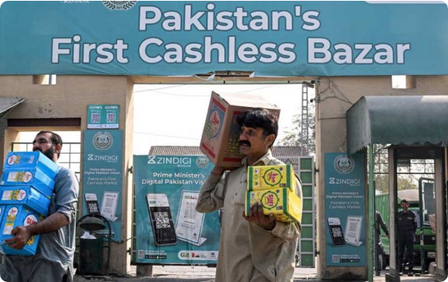



Slide 02 • Operational Context
Problem & Target Users in Wholesale Khatas
Who is Affected?
Wholesale market traders, grain/cloth dealers, and bookkeepers (Munshis) recording high-velocity daily transactions manually in paper Khatas.
The Current Bottleneck Workflow
Handwritten logs → manual ledger reconciliation → manual calculation of debit/credit tallies → human transcription errors causing revenue leaks.
The Privacy Impasse
Merchants actively refuse cloud SaaS apps (DigiKhata, Udhaar) due to commercial confidentiality and fear of third-party data aggregation.
Target Environment: Traditional wholesale markets with offline, paper-centric bookkeeping.

Slide 3


Slide 03 • Benchmark & Gap Analysis
Solution Landscape & Structural Limitations
Existing Paradigm | Core Technical Approach | Evidenced Failure Modes | Our System Architectural Advantage
Local Digital Khatas (EasyKhata, Udhaar) | Manual CRUD entry + centralized cloud DB storage | Zero OCR Automation 100% manual typing; leaks commercial turnover to cloud servers | 100% Offline Sovereignty Computer vision automated tabular entry at local edge
Cloud OCR APIs (Google Vision, AWS Textract) | Generalized deep learning text recognition models | Nastaliq Failure (<60%) Outputs unstructured strings without preserving debit/credit links | Domain-Constrained HTR Cell-level segmentation tailored for cursive Urdu ligatures
Enterprise ERPs (QuickBooks, SAP) | Latin-centric OCR + fixed rule accounting engines | Script Incompatibility Cannot ingest variable Pakistani merchant register conventions | Khata Register Awareness Engineered around traditional bilateral account formats
The Core Gap: Localization alone is not sufficient. Offline execution mandates quantized edge inference, strict tabular reconstruction, and tamper-evident local auditability.

Slide 4






Slide 04 • Technical Grounding
R&D Foundation: Preprocessing, HTR & Security
Computer Vision Core
HTR Sequence Model
Tamper-Proof Audit
OpenCV Perspective Invariance: Four-point contour detection, Otsu adaptive binarization, and morphological projection profiles to isolate warped tabular cells.
TrOCR & CRNN Architecture: Vision Transformer encoder with autoregressive language model decoder, constrained by localized Urdu vocabulary and numeral dictionaries.
Row-Level HMAC Signatures: SHA-256 hash chains with append-only PostgreSQL triggers to guarantee internal fraud prevention without overhead of a full blockchain.
Academic Tool Boundary Disclosure:
TrOCR Base Weights (Core-Assist) • Custom Segmentation & Verification Engine (Student-Owned CCP)

Slide 5



Slide 05 • Seoul Accord Criteria
Complex Computing Problem (CCP) Justification
Conflicting Requirements
Beyond Standard Practice
Heavy transformer-based sequence inference must execute entirely on local, mid-tier shopkeeper PCs without cloud offloading or external GPU clusters.
Urdu Nastaliq features diagonal cascading ligatures and high character overlap. Off-the-shelf Latin/printed OCR frameworks fail catastrophically on handwritten Khatas.
Zero Financial Defect Tolerance
Insider Tamper-Proof Auditability
Financial mutations cannot tolerate OCR hallucinations. System enforces a statistical confidence gate that intercepts low-probability predictions before database commits.
Addresses unauthorized alterations by internal operators (Munshis) through immutable cryptographic hash chains and strict role-based access control (RBAC).

Slide 6







Slide 06 • System Blueprint
End-to-End System Pipeline & Architecture
Raw Photo
OpenCV Preproc
HTR Engine
Confidence Gate
HITL Verify
HMAC & Audit
Formal Engineering Contribution Statement:
An offline-first financial digitization pipeline uniting perspective-invariant Urdu tabular cell segmentation, domain-constrained HTR sequence modeling, cryptographic row-level HMAC auditing, and a HITL verification feedback loop that enables continual local transfer learning on merchant handwriting.

Slide 7

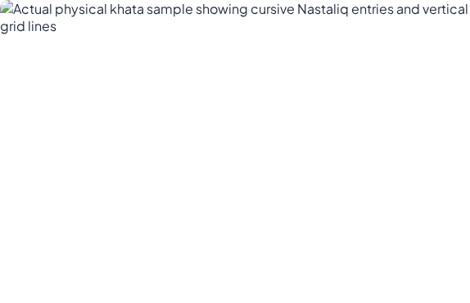



Slide 07 • Proposal Feasibility Spike
POC Evidence: Real Ledger Preprocessing Spike
Tested Risk: Generic OCR Catastrophic Failure
Feeding this un-flattened image directly into off-the-shelf OCR engines results in 100% garbage text tokens and total loss of debit/credit columnar association.
Technical Spike Demonstrated
OpenCV contour alignment isolates tabular rows, deskews lines, and extracts bounding-box cell crops, providing high-contrast localized segments for the HTR engine.
Architectural Decision Justified:
Confirms that HTR must operate on pre-segmented tabular cells paired with confidence scoring to prevent incorrect financial mutations.
Unconstrained Physical Khata (Faded ink, slanted text, phone capture)

Slide 8




Slide 08 • Rigorous Benchmarks
Evaluation Metrics & RAID Risk Register
< 10%
98%+
3.5x
Character & Word Error Rate
Confidence-Rejection Accuracy
Task Efficiency Speedup
CER / WER across currency & accounts
Low-confidence threshold catches bad reads
Scan & verify 50 rows vs manual entry
Risk Factor | Identified Failure Mode | Engineered Mitigation Strategy
Column Drift | Missing bounding lines causing debit/credit swap | Vertical projection profile analysis to lock spatial coordinates
Operator Fatigue | High rejection rate overwhelming user during verification | Continuous local fine-tuning loop adapts to shopkeeper handwriting
Munshi Overreach | Bookkeepers with administrative credentials altering past logs | Strict Role-Based Access Control (RBAC) + tamper-evident HMAC chains

Slide 9








Slide 09 • Work Division & Roadmap
Team Ownership Matrix & Milestones
Talal Shahid
Irbaz Ali
Muhammad Ibrahim
CV & Machine Learning Core
Full-Stack & Security
Database, Audit Logic & HITL
OpenCV tabular cell segmentation
Next.js high-throughput verification UI
PostgreSQL double-entry schema
Perspective & shadow deskewing
FastAPI backend orchestration
Row-level HMAC cryptographic signing
TrOCR / CRNN sequence models
Role-Based Access Control (RBAC)
HITL engine & routing gate
Statistical confidence calibration
Platform security integration
Continuous local fine-tuning worker
GATE 1 • PROPOSAL
GATES 2 & 3 • MID-1
GATE • FINAL-1
GATE 4 • MID-2
GATE 5 • FINAL-2
Feasibility Spike Accepted
SRS/SDS + Base TrOCR
End-to-End Core Accepted
Audit Engine + HMAC
Field UAT & Deployment

Slide 10






Slide 10 • Compliance & Responsibility
DEI, Ethical, and Legal Governance
DEI Accessibility
Ethical Data Governance
Legal & Privacy Sovereignty
Designed specifically for semi-literate bookkeepers and traditional merchants. Minimalist Urdu-first UI ensures digital empowerment across varied socio-economic demographics without requiring English literacy.
Explicit informed consent protocols for all gathered ledger samples. Strict de-identification of customer identities before local fine-tuning to protect wholesale commercial trade secrets.
Zero telemetry or cloud exfiltration. Compliant with local electronic transaction regulations and data-residency standards through sealed on-premise local Docker containers.
UN Sustainable Development Goals (SDGs):
SDG 8 (Decent Work & Economic Growth) • SDG 9 (Industry, Innovation & Infrastructure)

Slide 11


Image Sources
https://asianews.network/wp-content/uploads/bfi_thumb/AFP__20251125__86424T3__v2__MidRes__PakistanEconomyBankingDigital-7psq1quq3x3k1wg93vkn9ql3uis39kyvllnkscieo1s.jpg
Source: asianews.network

